Slide 1
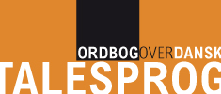
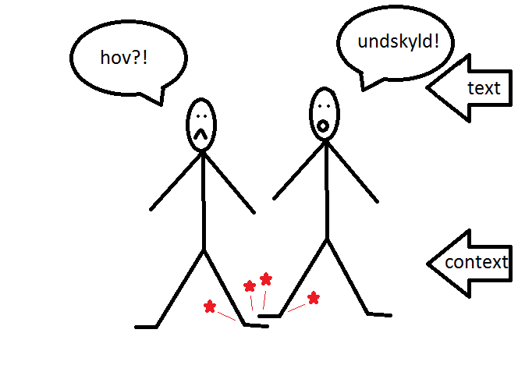
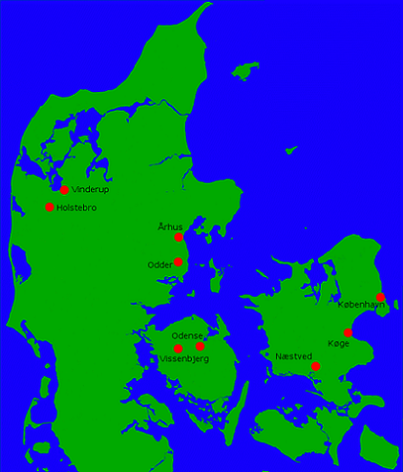
A Dictionary of Spoken Danish (ODT)
Carsten Hansen & Martin H. Hansen
The LANCHART Centre of Copenhagen
The concept
The dictionary ODT is designed to be a web-based dictionary portal, mainly based on the LANCHART corpus supplemented with various other resources on spoken and written Danish.
Its main focus will be on the features that distinguish spoken language from written. As a consequence, the interactional and pragmatic functions of spoken language are emphasized.
Text internal (e.g. turn taking) and text external context plays a central role.
The corpus
The LANCHART corpus consists of 6.5 million tokens of spoken Danish, mainly from sociolinguistic interviews carried out from 1978 to today.
The corpus annotation allows for a description on two different discursive levels:
- A sociolinguistic description with regard to age, gender, geography, social class, and distribution in real time over three decades
- A discourse context annotation that breaks the conversation into various genres, interaction types, speech act types, and activity types.
The data
All conversation in the corpus has been transcribed and can be accessed in the form of traditional concordance lines. Apart from this, the sound files them-selves will be consulted in order to distinguish between different forms and functions of lexemes.
Linguistic variation
Example: Laughter To illustrate the potential value of adding discursive distribution to a dictionary entry, a simple survey was carried out on the distribution of laughter. While laughter is not traditionally considered language, it shares the property of having various interactional and pragmatic functions. Note that for this simple survey, all different kinds of laughter were treated as one.
Figure 3 shows that younger people seem to laugh more often than older people, and that women laugh more often than men.
Figure 4 shows that the frequency of laughter varies a great deal between different genres.
Similar variation studies can be automated from the corpus data for all dictionary entries and for several more parameters than the ones showed here. The problem of presenting these data in a meaningful way in the final dictionary remains to be solved.
Function groups and Functional profiles
When compiling the dictionary we practice two different procedures, a semasiological and an onomasio-logical.
In the first procedure, we go through all the instances of a certain lexeme in the corpus, for example the interjections undskyld (≈sorry) and hov (≈oops), and we then allocate each use of the lexeme to a function group. All the functions of a lexeme found are part of the functional profile.
The dictionary entry
Each dictionary entry will contain cross references (links) to the function groups to which the lemma belongs. As can be seen from Figure 5, members of a function group are not necessarily semantic equivalents which can be interchanged freely.
As each function group is described through one or more features, the list of features can be enhanced. An obvious feature – not included in this presentation – is prosody, as the ODT web-based dictionary will also contain audible sound clips.
In the second procedure, we supplement these function groups with candidates gleaned from the semasio-logical analytic procedure. We check whether the functional profiles can add new functions to the total inventory of function groups.
The relation between function groups and the functional profiles of the interjections undskyld and hov is illustrated in Figure 5 beneath:
The full list of functions that the lemma can perform – its functional profile – will be supplemented with corpus based information about the discursive as well as sociolinguistic variation within each function group.
CH & MH
 | Functional profile of undskyld (≈sorry) | Functional profile of hov (≈oops)
Function group: surprise |  | hov¹ (oops) Used to mark surprise, often inter-rupting the ongoing conversation
Function group: regret (text external) | undskyld¹ Undskyld! [jeg trådte dig over tæerne] (Sorry! [that I stepped on your foot])
Function group: regret (text internal) | undskyld² Undskyld jeg spørger, men ... (Sorry for asking, but …)
Function group: correction of self (text external) |  | hov² Hov, jeg trådte dig over tæerne (Oops, I stepped on your foot)
Function group: correction of self (text internal) | undskyld³ Det er mod øst, undskyld, mod vest (It’s east, sorry west) | hov³ Hov, jeg havde nær glemt at spørge... (Oh, I almost forgot to ask ...)
Function group: correction of other (text external) |  | hov⁴ Hov, ikke springe over i køen! (Hey, don't jump the line!)
Function group: correction of other (text internal) | undskyld⁴ Undskyld, det hørte jeg ikke (Sorry, I didn't hear that) | hov⁵ Hov, tal pænt! (Hey, speak properly!)
Function group: establishing contact | undskyld⁵ Undskyld jeg forstyrrer (Excuse me for interrupting) | hov⁶ Hov, du tabte noget! (Hey, you lost something!)
Figure 1 Conversation in context
Figure 3 Laughter frequency distributed over age and gender
Figure 5
Figure 4 Laughter frequency distributed over selected genres
Figure 2 The geographical stratification of the LANCHART Corpus

